Slide 1
Prussia in Seven Years War
VR150 Presentation
XuWenwen
Notes:
Let us begin today's topic, the Seven Year's War. The war is the outcome of years of tension in Europe, mainly the conflicts between Great Britain and France, struggle between Prussia and Austria. I will cover more on Prussia, especially the achievements of Fredrick the Great. As I believe that war is the extension of politics, I will also try to cover the complicated European diplomatical relationships at the time.
The major powers of our topic are France, Britain, Austria, Russia, Prussia. The European continent at the time is generally dominated by the conflict of France and Britain. Austria has been historically a powerful nation, but got reduced by a large extent in the Austria Succession War. The lesser powers cannot possibly get out of the conflict, they have to choose side, one way or another, between France and Britain. France is seeking dominance of the whole Europe, while Britain is seeking to balance the power on the European continent.

Slide 2
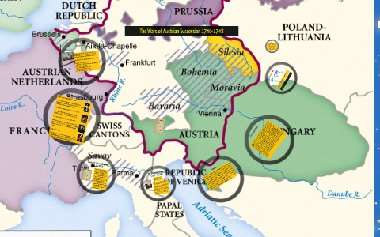
Aftermath of Austrian succession war (1748)
Britain and Austria against France and Prussia
Austria was severely damaged not only by enemies but also by ally diplomatic pressure
Prussia gained Silicia from Austria, doubled in size and population
Notes:
The seeds of the Seven Years’ War were sown in the 1748 Treaty of Aix-la-Chapelle, which ended the Austrian Succession War. The war started by France, Prussia, Bavaria, and Saxony claiming Maria Theresa illegal successor of Austrian throne. To put it simple, the former Emperor Charles the Sixth did not have male heir, everyone thinks Maria Theresa is not competent enough to handle a severe situation, and decide to grab some profits from the chaos. Britain, not willing France to gain too much profit out of that, supported the Austrian heiress.
Here I explain more about the complex diplomatic relationship. Austria was a nation on steep downhill, France and Prussia can directly gain profit from Austria in terms of territory. At the same time, Britain is hostile to France for the oversea colony issues, so Britain is willing to provide financial support to Austria, and take down part of French power at the expense of Austrian lives. Very well planned scheme. But at the same time we can see that Britain didn't care if Austria loses. By recognizing Britain as ally, Austria paid a dear price. Maria Theresa had given up most of Lombardy and occupied Bavaria. The British also forced her to cede Parma to Spain and, the most important of all is to abandon the valuable state of Silesia to Prussian occupation. This was considered humiliation to the Hapsburg Family, to lose territory not because of failure in war, but because of ally diplomatic pressure. Here is a weird thing. Britain is pressuring her ally, Austria, to give territory to her enemy, Austria. Why is the case? Of course on one hand, the king of Prussia will likely continue the war if Austria did not give him territory, on the other hand, we have just mentioned, Britain didn't care if Austria loses. But why give Prussia such a large and valuable state? Here I quote a statement from the British political comedy, Yes, Minister. It says "British policy on Europe hasn't changed for the past nine hundred years, that is to create a disunited Europe." When everything goes stable in Europe, Britain will try to mess up the relationship by all means, so that no strong power will rise against Britain. That is why Prussia gained Silicia out of no where. The conflict between Austria and Prussia heated up greatly, by British foreign policy.

Slide 3
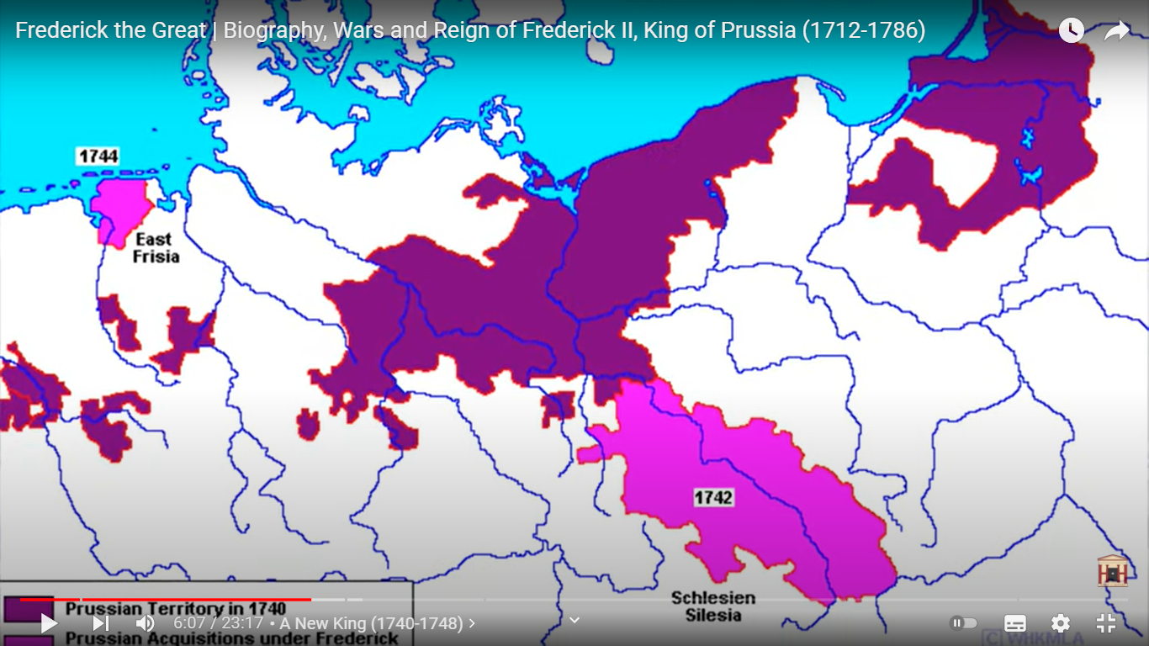
Rise of Prussia
Prussia was still not considered a major power at the time
Prussia territory doubled suddenly
Notes:
As expected, Austrians were the biggest loser of the war. In the Treaty of Aix-la-Chapelle, Theresa was recognized as the monarch of Austria, but as we said, Austria lost the region of Silicia to Prussia, which basically doubled Prussian terrirory and population, and made Prussia the biggest winner. Here we see that Prussian territory is actually much divided at the time. The official name of Prussia is Brandenburg-Prussia, where Brandenburg is part of Holy Roman Empire, Prussia is part of Polish-Lithuanian Confederation. They are both under the reign of Fredrick the Great. After the Austrian Succession War, Prussian territory increased by a large extent.
Meanwhile, the treaty had left all parties other than Prussia dissatisfied. Britain and France did not gain the profits they expected. They were expecting to have some influence on the weaker Austria and Prussia, but after the war, Austria is still recovering from the chaos, too weak to gain any profit from. While Prussia is too strong and aggressive to be influenced. There is clear sign that Prussia is about to rise as a major European superpower.

Slide 4
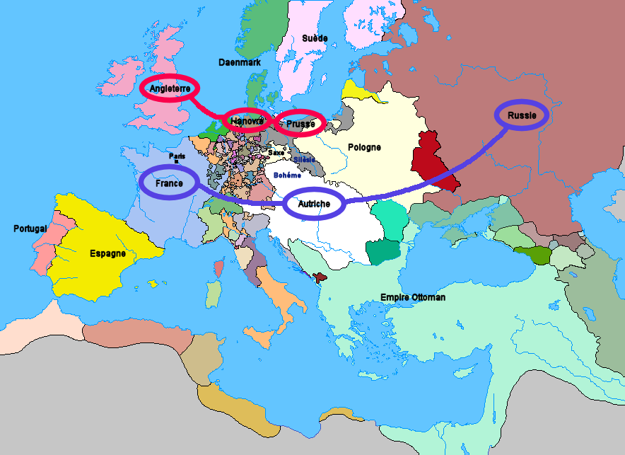
“Diplomatic revolution”
France, Russia Austria alliance against Prussia, Hanover, Britain
Notes:
For this reason, between 1748 and 1756, a "diplomatic revolution" in Europe swapped around these alliances. Britain is subsidying Russian forces at Russian-Prussian border, Fredrick took the chance to negotiate with Britain, to get Britain as alliance with Prussia, without consulting the former ally France. France became immediately mad at Prussia, Russia was not happy with Britain stopping financial support as well. In one move, Prussia made friend with Britain, but made enemies with Austria, France and Russia at the same time. The diplomatic revolution can in some sense, be interpreted as a failure of Fredrick the Great. Britain's alliance with Prussia is of the same purpose as that with Austria. Britain simply wanted to take out enemies without bothering Britain's own army. They have much more to do in North American colonies anyway. So by allying with Britain, Prussia is claiming hostility to France, a much closer threat. This led to Prussia facing the army of France, Prussia and Russia at the same time.
The thing is, France still want to maintain her longlasting status among the German states, so France is not willing to see a strong power rise among the Germans. Meanwhile, Britain want to balance the power of Europe, and Austria simply seek to revenge on Prussia to take back Silicia while Fredrick the Second hasn't established entire control over the region. Prussia did swallow too much territory in one gulp. If we recall history, we can easily see nations who gain much territory by military means usually will face lots of problems.

Slide 5
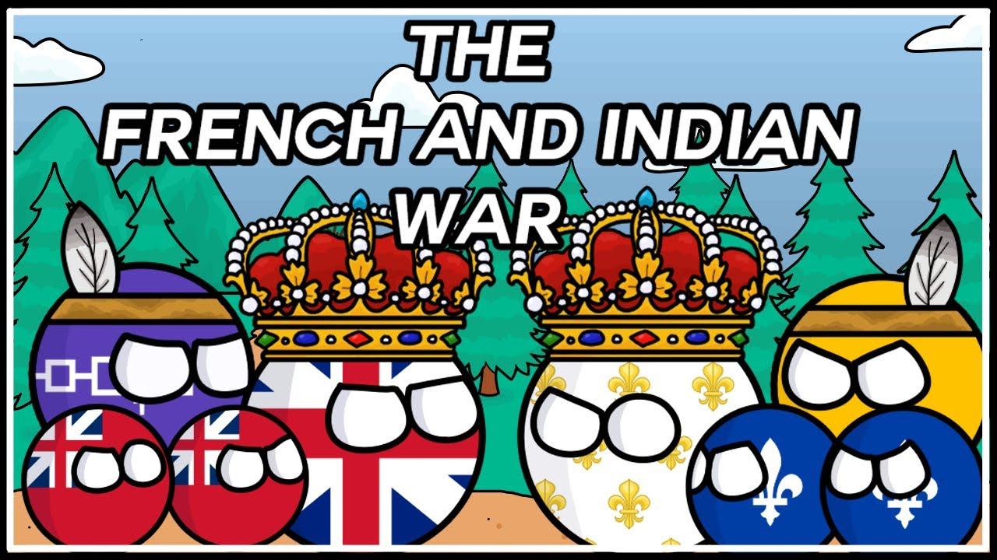
War broke out in North America (1754)
French and British attack each other’s trading posts in North America
Notes:
The war broke out in the continent of North America, where Great Britain and France were fighting over the control of colonies. This is otherwise regarded as the French and Indian War, though this is not the major topic today. France and Britain are putting a lot of armies in America. This is bad news for Fredrick the Great. Without the help of British armies, he would have to fight three empires at the same time. The war in Europe started when Prussia attacked Saxony, with the excuse that Saxony is plotting against Prussia. This turned out to be a move with much oversight, the occupied territory of Saxony provided much financial and manpower aid during the war, its strategic position slowed down the progress of the allied armies to a large extent.
Here is a side note, the Seven Year's War is divided into multiple places. The war on North America is usually refered as the French and Indian War, the war between Austria and Prussia, the Third Silician War, the war between Prussia and Russia, the Pomeranian War, there are other conflicts on North Africa, South America, South Asia as well.

Slide 6
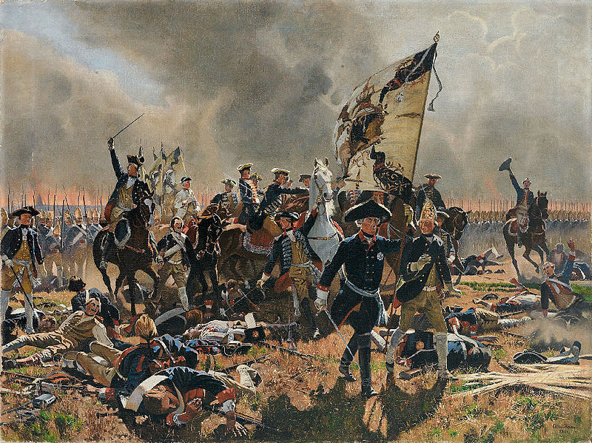
Fredrick the great as a military leader
Battle of Rossbach
Battle of Leuten
Battle of Zorndorf
Notes:
The Third Silician War is indeed a masterpiece for Friedrich the Great. He achieved several impossible victories against the odd in the war. In the battle of Rossbach, he faced the combined forces of France and Austria, twice as large as his own, and took out ten thousand troops at the expense of five hundred. In the Battle of Leuthen, he inflicted twenty two thousand casualties with a forty thousand men army. In the battle of Zorndorf, he defeated a Russian army larger than his army, though suffering considerable casualty himself. Despite the constant victories of Fredrick the Great, he was at the same time, losing on all sides. How is this a thing? Well, the king's tactic is to rely on the better trained and disciplined Prussian troops to quickly outmaneuver the enemy. But as he need to face three enemies at the same time, he cannot be in three places at the same time, so the Prussian troops are becoming more and more exhausted at marching from places to places.

Slide 7
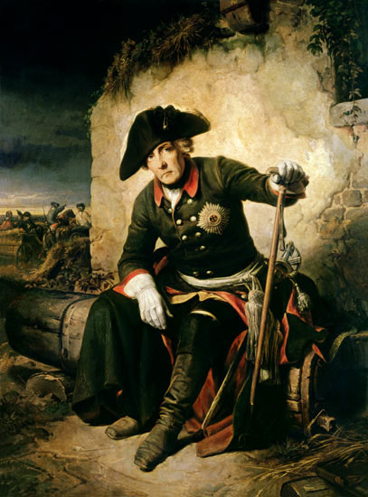
After the defeat OF KUNERNSDORF (1760)
The Battle of Kunernsdorf, the exhausted Prussian troops were defeated by Russian unexpected attack
Prussia was being closed in on all sides, the Russian, French and Austrians laid siege on Berlin
Prussia had a hard time clinging on
Notes:
In the Battle of Kunernsdorf, Fredrick the Great suffered a major defeat. He was gambling on defeating the French army before the Russian arrives. But the Russians came at the most unexpected time, and smashed the Prussian flank. Now we see that though the king had won so many battles, whenever he won, there is more for him to fight, but when he loses, everything is over for him. After the defeat at Kunernsdorf, Fredrick the Great can only retreat all the way to Berlin, desperately clinging on, wait for something to happen. If there is time I should have got the map of the battle field, and discuss more about how the battle went on in detail. But it will probably be not suitable for a presentation on class.
The war was at a critical point when Russian, French and Austrian armies besieged Berlin. The situation was almost deadly for Fredrich the Great. Britain, as we can expect, stopped financially supporting the Prussians, since they are struggling on the continent of North America as well. There is some saying that the king had a piece of poison tied on his jacket, and was preparing to commit suicide at any time. We can see from this portrait, there is rarely any king in history showing up on a portrait with this kind of facial expression. He just look like an ordinary soldier, waiting desperately for the war to go over.

Slide 8
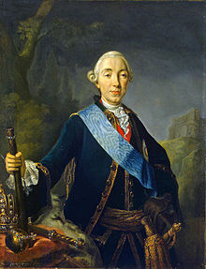
Miracle of the Brandenburg family (1762)
Tsarina Elizabeth I died suddenly.
Her successor Tsar Peter III switched sides all of a sudden.
Peter III was killed in palace coup by his wife Catherine II.
Russia pulled out of war in total chaos.
Notes:
However, the most dramatic part of the story came. The Russian Tsarina Elizabeth the First passed away, she was replaced by Tsar Peter the Third. Just because of his admiration of Fredrich the Great, he ordered the Russian army to make peace with Prussia and switch sides to Prussia. The unexpected change allowed Fredrich the Great to break the siege of Berlin and made the counter attack. Meanwhile, in Russia, Peter the Third was abolished by his own wife, Catherine the Great, a more familiar name may be Etkachelina. (I have no idea how translation between different language works.) Peter the Third was portraited like this. I cannot even find a better looking picture. This shows how people see him. Anyway, The story really blew my mind. I have always been the believer that history cannot be changed by a single individual, no matter who the person is. However, in this case, an infamously incompetent Tsar, Peter the Third, who only realmed for half a year before being abolished, saved one of the most respected Prussian military leader just by his own will. It is really hard to imagine how Europe would be if the dramatic event did not happen. The event is later named as the Miracle of the Brandenburg Family. Well, the miracle is that some opponent randomly died, and an incompetent successor took her place? It is just so weird.

Slide 9
Treaty of hubertensburg (1763)
All territories in Europe unchanged.
All monarchs unchanged.
Nothing changed.
Everyone stop waging wars.
Notes:
As a result, the war ended out of everyone's expectation. The sudden switching side of Russia gave Fredrick the Great much time to react, and push the remaining hostile forces out of Prussia. The war ended with the Treaty of Hubertensburg, which states that all territories in Europe remain unchanged. This rarely happens. But this is the end of a war of attrition, everyone is clinging on, struggling to keep up with their opponents. France got heavily defeated in North America by Britain, Russia pulled out of the war, both Prussia and Austria were too exhausted to make any further attack.

Slide 10
Aftermath of the Seven Years war
France lose all North America colonies to Britain
Britain then lose most of them in later Independence war, supported by the French king
Russia, Austria, Prussia had much time to recover.
Notes:
The aftermath of the war is horrenous. Though Great Britain, Prussia, Russia were on the winning side, there is no actual winner of the war. They just "lose less". Britain quickly ran into economic problems, which led to harsh taxations in North America, which then led to the independence war. The French King, seeking revenge, supported the Independence War, which led to economic problem in France as well, and then the well-known Revolution. France also lost lots of her oversea territory to Britain. The Russians basically spent the resource to fight two wars, but the only outcome for winning is just a reputation of being trecherous. Prussia was respected for standing up against three major European powers, but the Prussian territory and population got severely damaged in the war as well. Of course as we said, Prussia did not get any territory from the war.

Slide 11
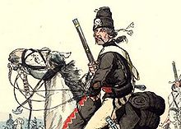
“A Nation owned by army”
Fredrick the Great took much more cautious diplomatic measures after the war.
Prussian army had already too much influence on the nation.
Notes:
Lots of people have the stereotype that Prussia, and the proceeding Germany is good at tactic but bad at strategy. The idea is proved by several wars, including the two world wars. Prussia was indeed very successful in terms of inflicting damage on opponents and capturing territories, but at the expense of her own manpower and economy. Prussia at the time was also too aggressive in terms of diplomatics, Fredrick the Great could have eased the tension between Britain and Russia, Russia and France, and face Austria as enemy only. This strategy is as we know, later done by Bismarck. He cautiously made friends with everyone except France. However, Fredrick the Great somehow made enemies with everyone except Britain.
Any nation put together by war usually doesn't last long, before they get torn apart by war. The empire of Qinshihuang, empire of Mongolia, empire of Napoleon were examples of the statement. After the Seven Year's War, Fredrick the Great almost returned from the dead. He had the statement: "After the war, I will not attack a cat." Just as he said, Prussia adpoted a much more cautious diplomacy, ditched the alliance with Britain and made alliance with Russia again. Prussia did not have any greater conflict with any Eurpoean power until the time of Napoleon. One of the achievements of later years of the king is the partition of Poland. By diplomatic pressure and negotiating, Prussia, Austria and Russia took away large portion of Poland territory. This finally made Prussian territory connect, and laid a solid foundation for Prussia to unify Germany.
Despite Fredrick the Great being more cautious on the policies, the damage on Prussia is too heavy to ignore. How to settle such an army, the army that had served the nation so well, did not abandon the king at the hardest time, and eventually gained the impossible victory of the war? The king had to prevent the army from rioting, so he had to give much pension to them. By the way, Prussian armies were known for their harsh discipline and good training. The flogging punishment remained until the early nineteenth century. They are also the most rewarding work. The officers are always paying their soldiers on time, and never hesitate to reward soldiers that behave bravely in battle. This stipulates the troops greatly. There was a song among the Prussian army that laughs at Russian armies never paying wages, French armies paying soldiers with luxuries, and so on. Though I feel that annoying these many superpowers in the same time is probably not a wise thing to do.

Slide 12
Friedrich Rex (part)
Unsre Artillerie hat ein vortrefflich Kaliber,
und von den Preußen geht keiner zum Feinde über,
die Schweden, die haben verflucht schlechtes Geld,
wer weiß, ob der Östreicher besseres hält.
Mit Pomade bezahlt den Franzosen sein König,
wir kriegen’s alle Woche bei Heller und Pfennig.
Potz Mohren, Blitz und Kreuzsakrament,
wer kriegt so prompt wie der Preuße sein Traktament?
Our artillery have excellent caliber,
none of the Prussians betrays their king,
the Swedes, they have damn bad money,
who knows whether the Austrian will be better.
The French King pays soldiers with pomade,
we get payment every week in cash.
The king pays us as fast as lightning ,
Who gets his wage as promptly as the Prussian?
Notes:
Just to demonstrate the king's idea on military leadership, I put part of the song Fredrick Rex here. The song directly insulted three powerful nations in this part of the lyric. They have insulted Russia in other parts. But the point is, what keeps the Prussian soldiers together is the timely and well-disciplined reward and supply for their effort. The song is much longer than this. The melody is the kind similar to mxbc. Whenever you hear it, it begins to echo in your brain. So, be aware of that if you wish to listen to that yourself.
The harsh discipline has a downside, which is signified as the war goes over. It is just like the dynasty of Qing in China. When a war is over, harsh discipline is no longer suitable. As we know, soldiers have to follow whatever order from officers. There is a clear hireachy who should follow whose order. When the officers become corrupted, it is likely that the whole army's morale goes down. This exactly the case. When Fredrich the Great passed away, the nation was at peace, lots of officers quickly began to sleep on their former glory, and become much more incompetent. Punishments on soldiers become more random, which is again a drop of morale. The nation, according to some critics, became "the nation owned by an army". The army did contribute a lot in the war, but as peace goes on, it is hard to make sure that the best trained army in Europe doesn't do anything unexpected at home. The king did give a lot to his army and officers. This eventually made the army a costly and ineffective entity wasting the nation's resources. At the beginning of Napoleonic War, the Prussian army had already became very incompetent.
The military influenced politics in Prussia and in later Germany for a very long time. Though Fredrick the Great already adapted much more cautious policies, the fact that Prussia is built on war can not be neglected. We see the rise of Prussia from military in the Seven Year's War, in later war against Denmark, Austria and France, we also see the downfall of military leadership in World War One. The nation took a long time to recover from the military influence.

Slide 13
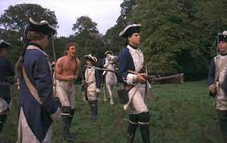
“A Nation owned by army”
Harsh discipline became a downside
Army is constantly wasting national income
Notes:
By the end of Frederick's reign, the army had become an integral part of Prussian society. It numbered 200,000 soldiers, making it the third-largest in Europe after the armies of Russia and Austria. The social classes were all expected to serve the state and its military — the nobility led the army, the middle class supplied the army, and the peasants composed the army.

Slide 14
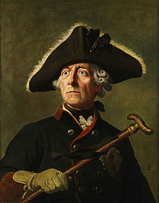
Fredrick the great
A great military leader recognized by the world
Made achievements in science, art, music, education as well
Could have made much more achievement if he was not given a nation destined for war
Notes:
At last I would like to cover a bit about the hero discussed many times in this presentation, Fredrick the Great. Fredrick the Great was considered until now, a very capable leader of Prussia, militarily and politically. As Napoleon invaded Prussia, he commented that "If this man is alive, I can not possibly be here". His several glorious battles became examples of lots of military academy. He had been severely overheroified during the Nazi reign period. He was propagandad as the precursor of Hitler, Hitler often compared himself with the Prussian king. When the Nazis evacuate to the bunker in Berlin, he always dreamed that some miracle will happen to him as that happened to Fredrick the Great. Fortunately this did not happen. Interestingly, despite the king's military genius, he was actually very interested in science, art, music, education, and architecture. Actually he was found to pass away peacefully when he was studying science. He had the Berlin State Opera House, Prussian Academy of Science, Royal Library set up during his reign, some part of these institutes still remain today. He had recruited Euler and Lagrange to his academy despite all the difficulties he face in his reign. He was also known to be very fond of dogs, he is the only European monarch that take dogs with him to formal meetings. He even had the will to be buried beside his dog. Though this may seem that he is a making the palace very messy, but in some sense, this is far better than having a lot of flatterers around him. Just like what happen in the palace of France and Russia. As we see, Fredrick the Great achieved a lot not only militarily but also politically. He started with an unstable kingdom, and ended up having a much more prosperous and united Prussia. And this is probably why he was respected and immortalized.

Slide 15
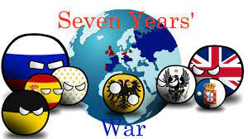
Notes:
That is all of my presentation, the Seven Year's War has much more to discuss about on the French, British, Austrian and Russian side of the war, a lot more to discuss about of Fredrick the Great and his reign. In my opinion, this is a vital part of Germany before the united Germany nation is even formed. That is why I wish to bring it up to share with you. Thank you.

Slide 16
References
https://en.wikipedia.org/wiki/War_of_the_Austrian_Succession#The_Peace_of_1748
https://www.britannica.com/event/War-of-the-Austrian-Succession
https://www.youtube.com/watch?v=-KRFz2AjRT8
https://en.wikipedia.org/wiki/Seven_Years%27_War
https://en.wikipedia.org/wiki/Peter_III_of_Russia
https://en.wikipedia.org/wiki/Frederick_the_Great
https://de.wikipedia.org/wiki/Fridericus-Rex-Grenadiermarsch
https://www.bilibili.com/video/BV1sx411w7Am

